Slide 1


Fraud Detection Case Study
Identifying Credit Card Fraudulent Transactions
Raghad Obeidat
Sep 27th 2025
Notes:
Photo by CoWomenon Unsplash

Slide 2
Agenda
Executive Summary
Introduction & Objectives
Dataset Overview
Exploratory Data Analysis (EDA)
Features Selection
Data Preprocessing
Model Building & Results
Business Impact
Key outcomes & Recommendations

Slide 3
Executive Summary
The Challenge
Our primary objective was to build a predictive model to move from a reactive to a proactive fraud detection strategy. The goal is to significantly reduce financial losses while safeguarding customer trust.
Uncovering Critical Fraud Patterns
Our analysis revealed that while fraud is rare overall (just 1.2% of transactions), it is not random. We discovered distinct patterns:
Concentrated Risk: Fraud is highly focused within specific merchant categories (travel, sports, health) and linked to a small number of high-risk merchants.
Clear Financial Signal: Fraudulent transactions consistently involve significantly higher monetary values, providing a clear signal for detection.
The Recommended Solution
We recommend deploying the Logistic Regression model, which was strategically selected for its superior fraud capture capabilities.
Maximum Detection: This model achieved the highest Recall rate (0.98) in our tests, successfully identifying 98% of all fraudulent activity.
Business Alignment: By prioritizing the highest possible detection rate, we directly address the severe business cost of missed fraud, aligning with a security-first strategy.

Slide 4

Introduction & Objectives
Introduction
Fraud detection remains one of the most critical challenges for financial institutions, as fraudulent credit card transactions can lead to significant financial losses and erode customer trust
Objective
Develop a machine learning model to detect fraudulent transactions, minimizing losses and protecting customers while keeping investigation workload manageable.
Approach: Data analysis → model training → evaluation.
Notes:
Photo by Austin Distelon Unsplash

Slide 5
Dataset Overview
Notes:
Photo by CoWomenon Unsplash

Slide 6
Dataset Overview
Columns: Step, Customer, Age, Gender, zipcodeOri, Merchant, zipMerchant, Category, Amount, Fraud.
Size: 594643 rows, 10 Columns
Target variable: Fraud (0 = non-fraud, 1 = fraud)
Imbalance: Fraud <1% of total transactions

Slide 7
Exploratory Data Analysis (EDA)
Notes:
Photo by CoWomenon Unsplash

Slide 8
Fraud (Target)
Non-Fraud (0) → 587,443 (98.79%)
Fraud (1) → 7,200 (1.21%)

Slide 9
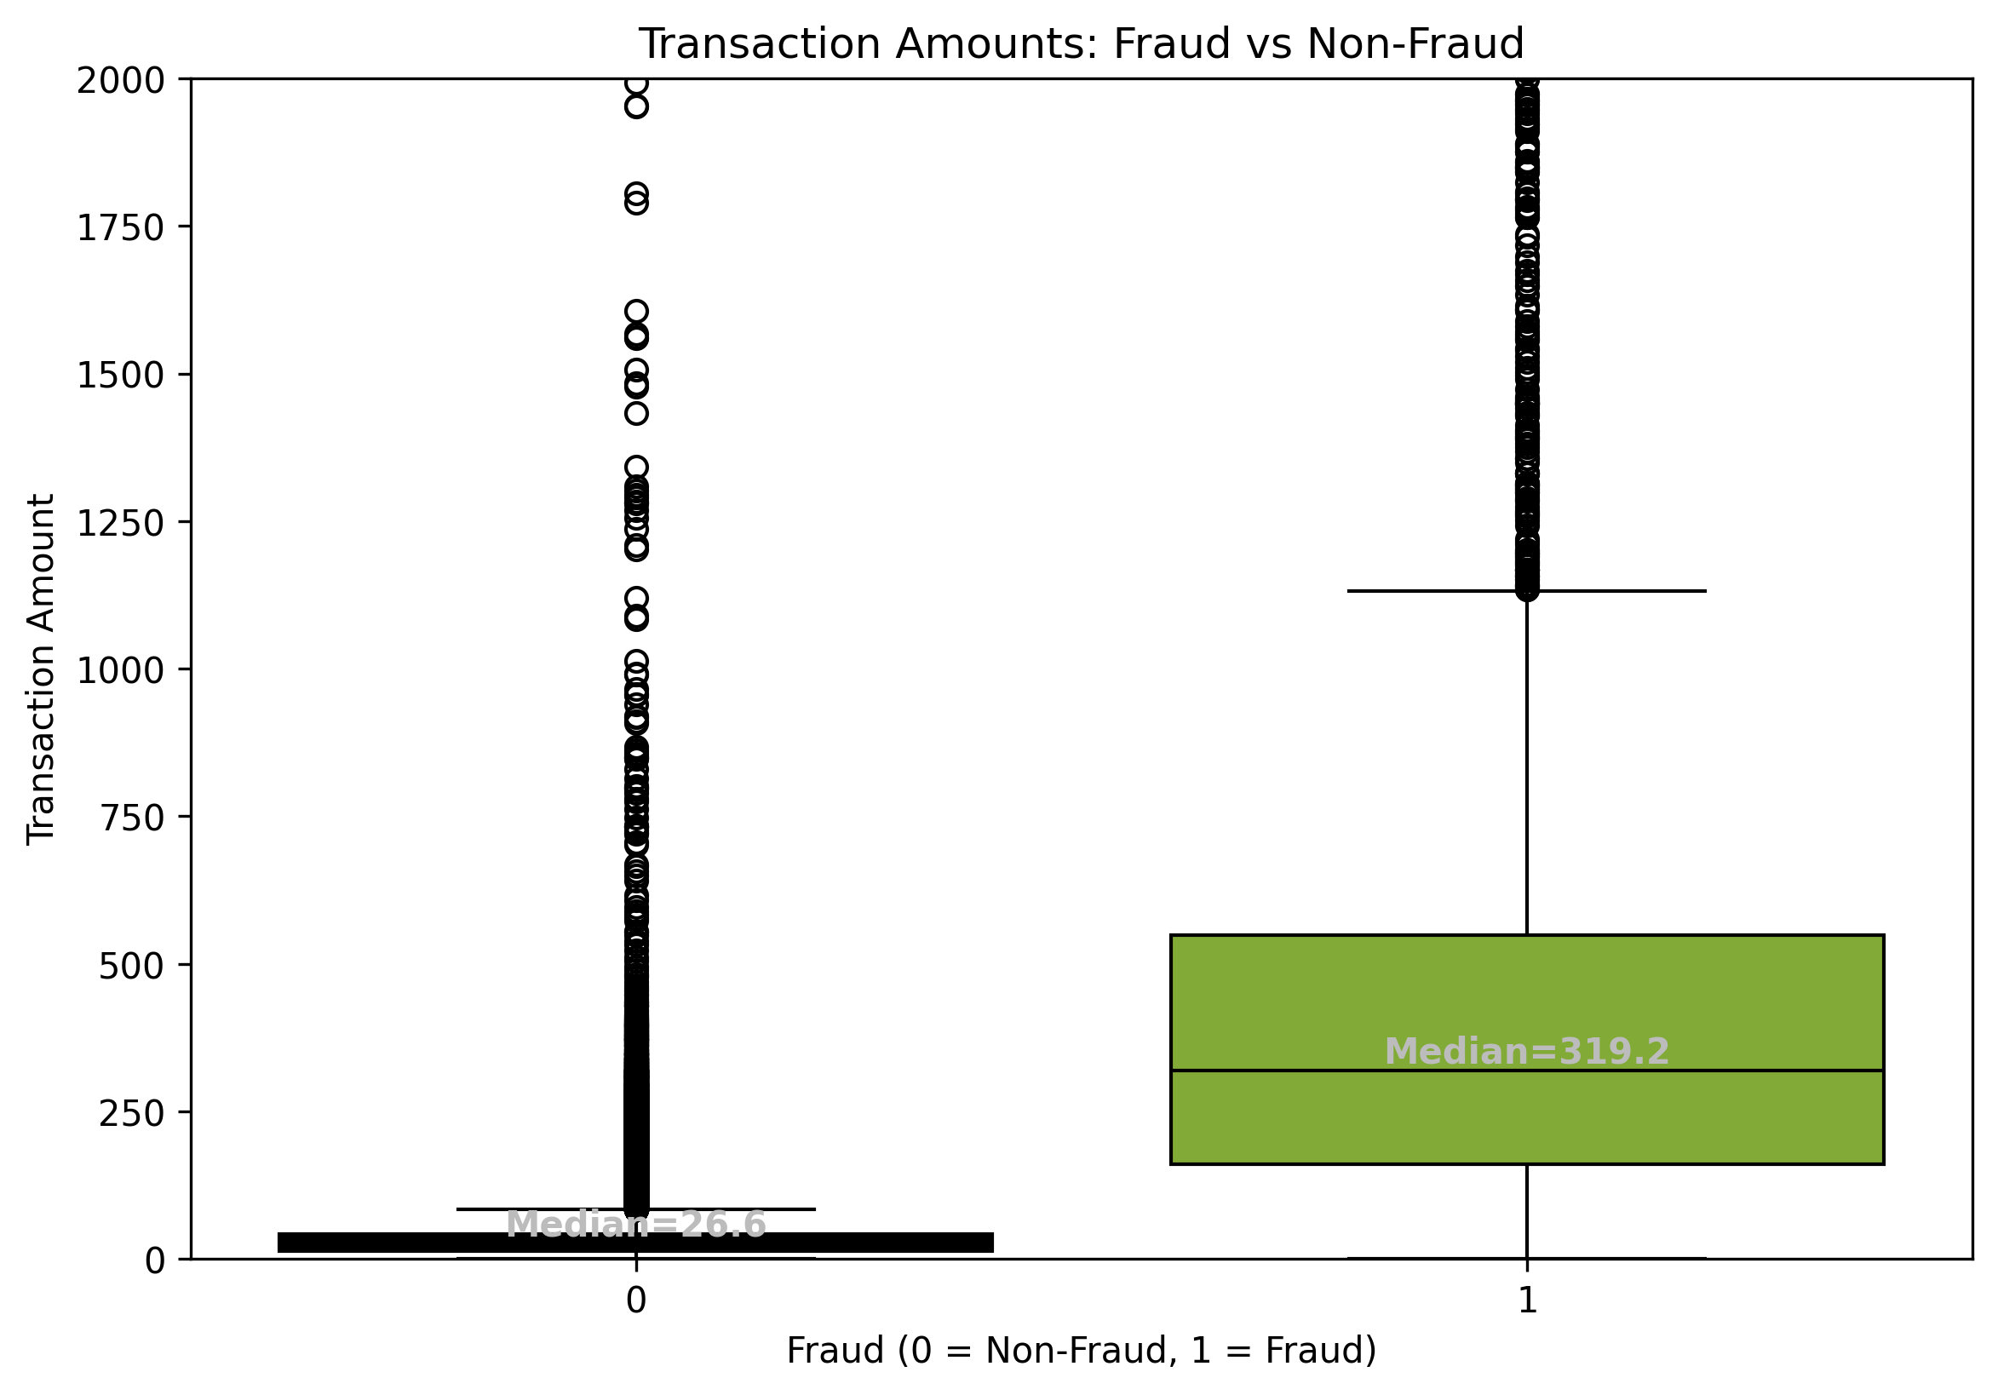
Transaction Amounts: Fraud vs Non-Fraud
Non-Fraud (0)
Typical amounts are very small (Median ≈ 27).
50% of transactions (Q1–Q3) fall between 14 and 42.
Rare outliers exist (Max ≈ 2,145).
Fraud (1)
Fraud transactions are much larger (Median ≈ 319).
50% of transactions fall between 160 and 549.
Outliers go extremely high (Max ≈ 8,330).
Variability is much higher (IQR ≈ 389 vs 28 for non-fraud).
Outliers were retained intentionally as they represent critical patterns of fraudulent behavior and contribute to model effectiveness.

Slide 10
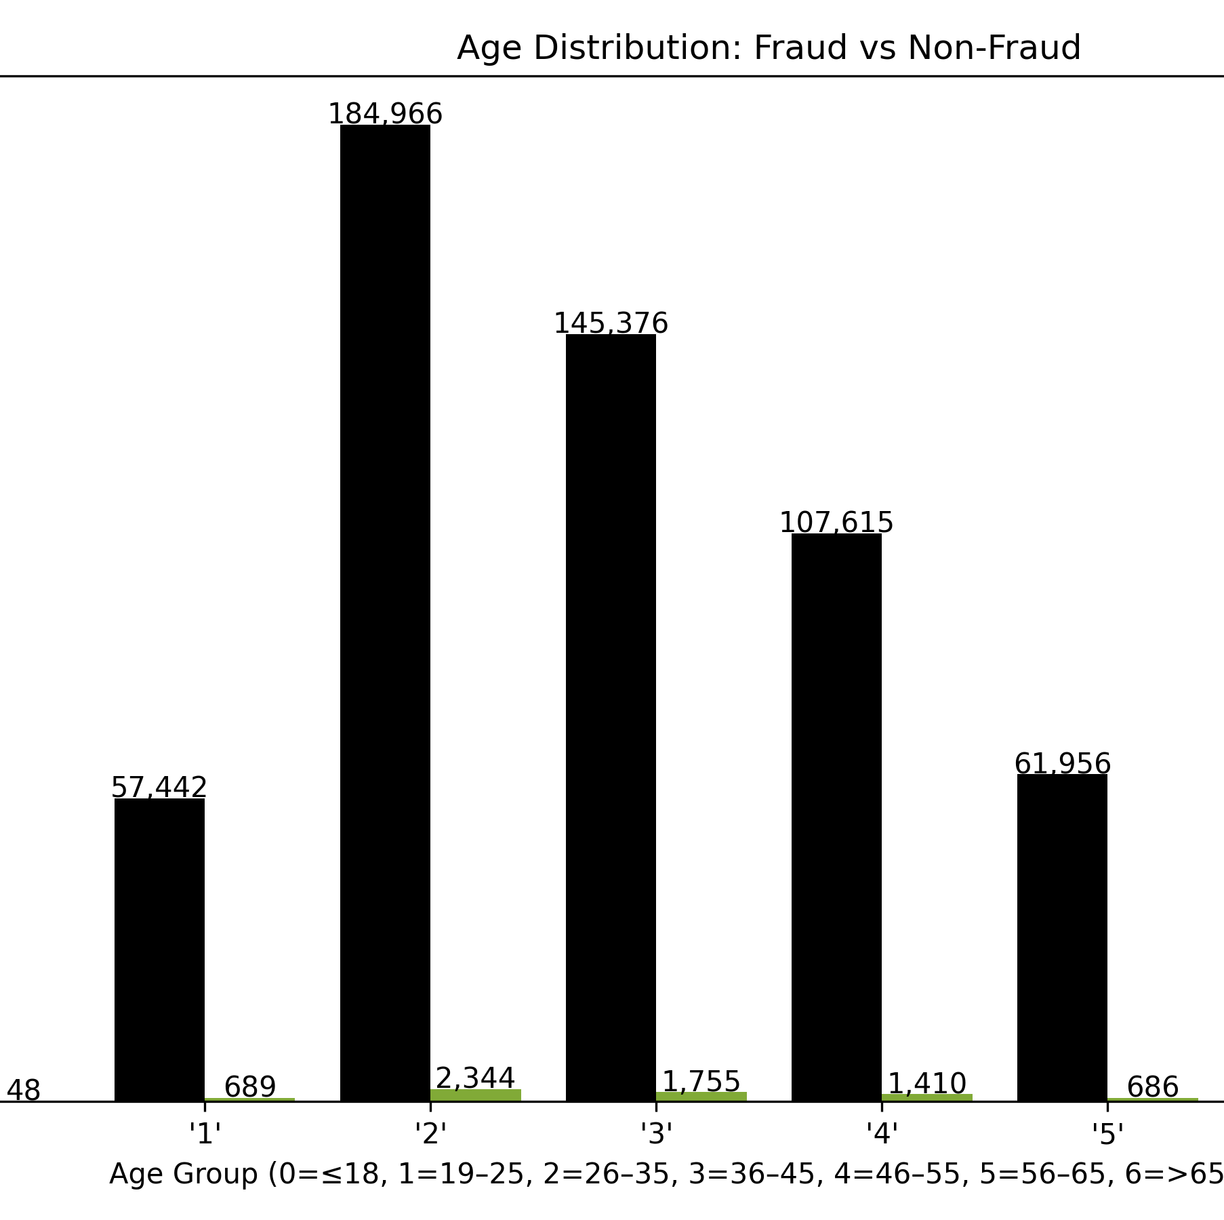
Age Distribution: Fraud vs Non-Fraud
Fraud mainly in 26–45 age groups.
19–25 also shows elevated fraud.
Minimal fraud in ≤18, >65,noted for data quality.

Slide 11
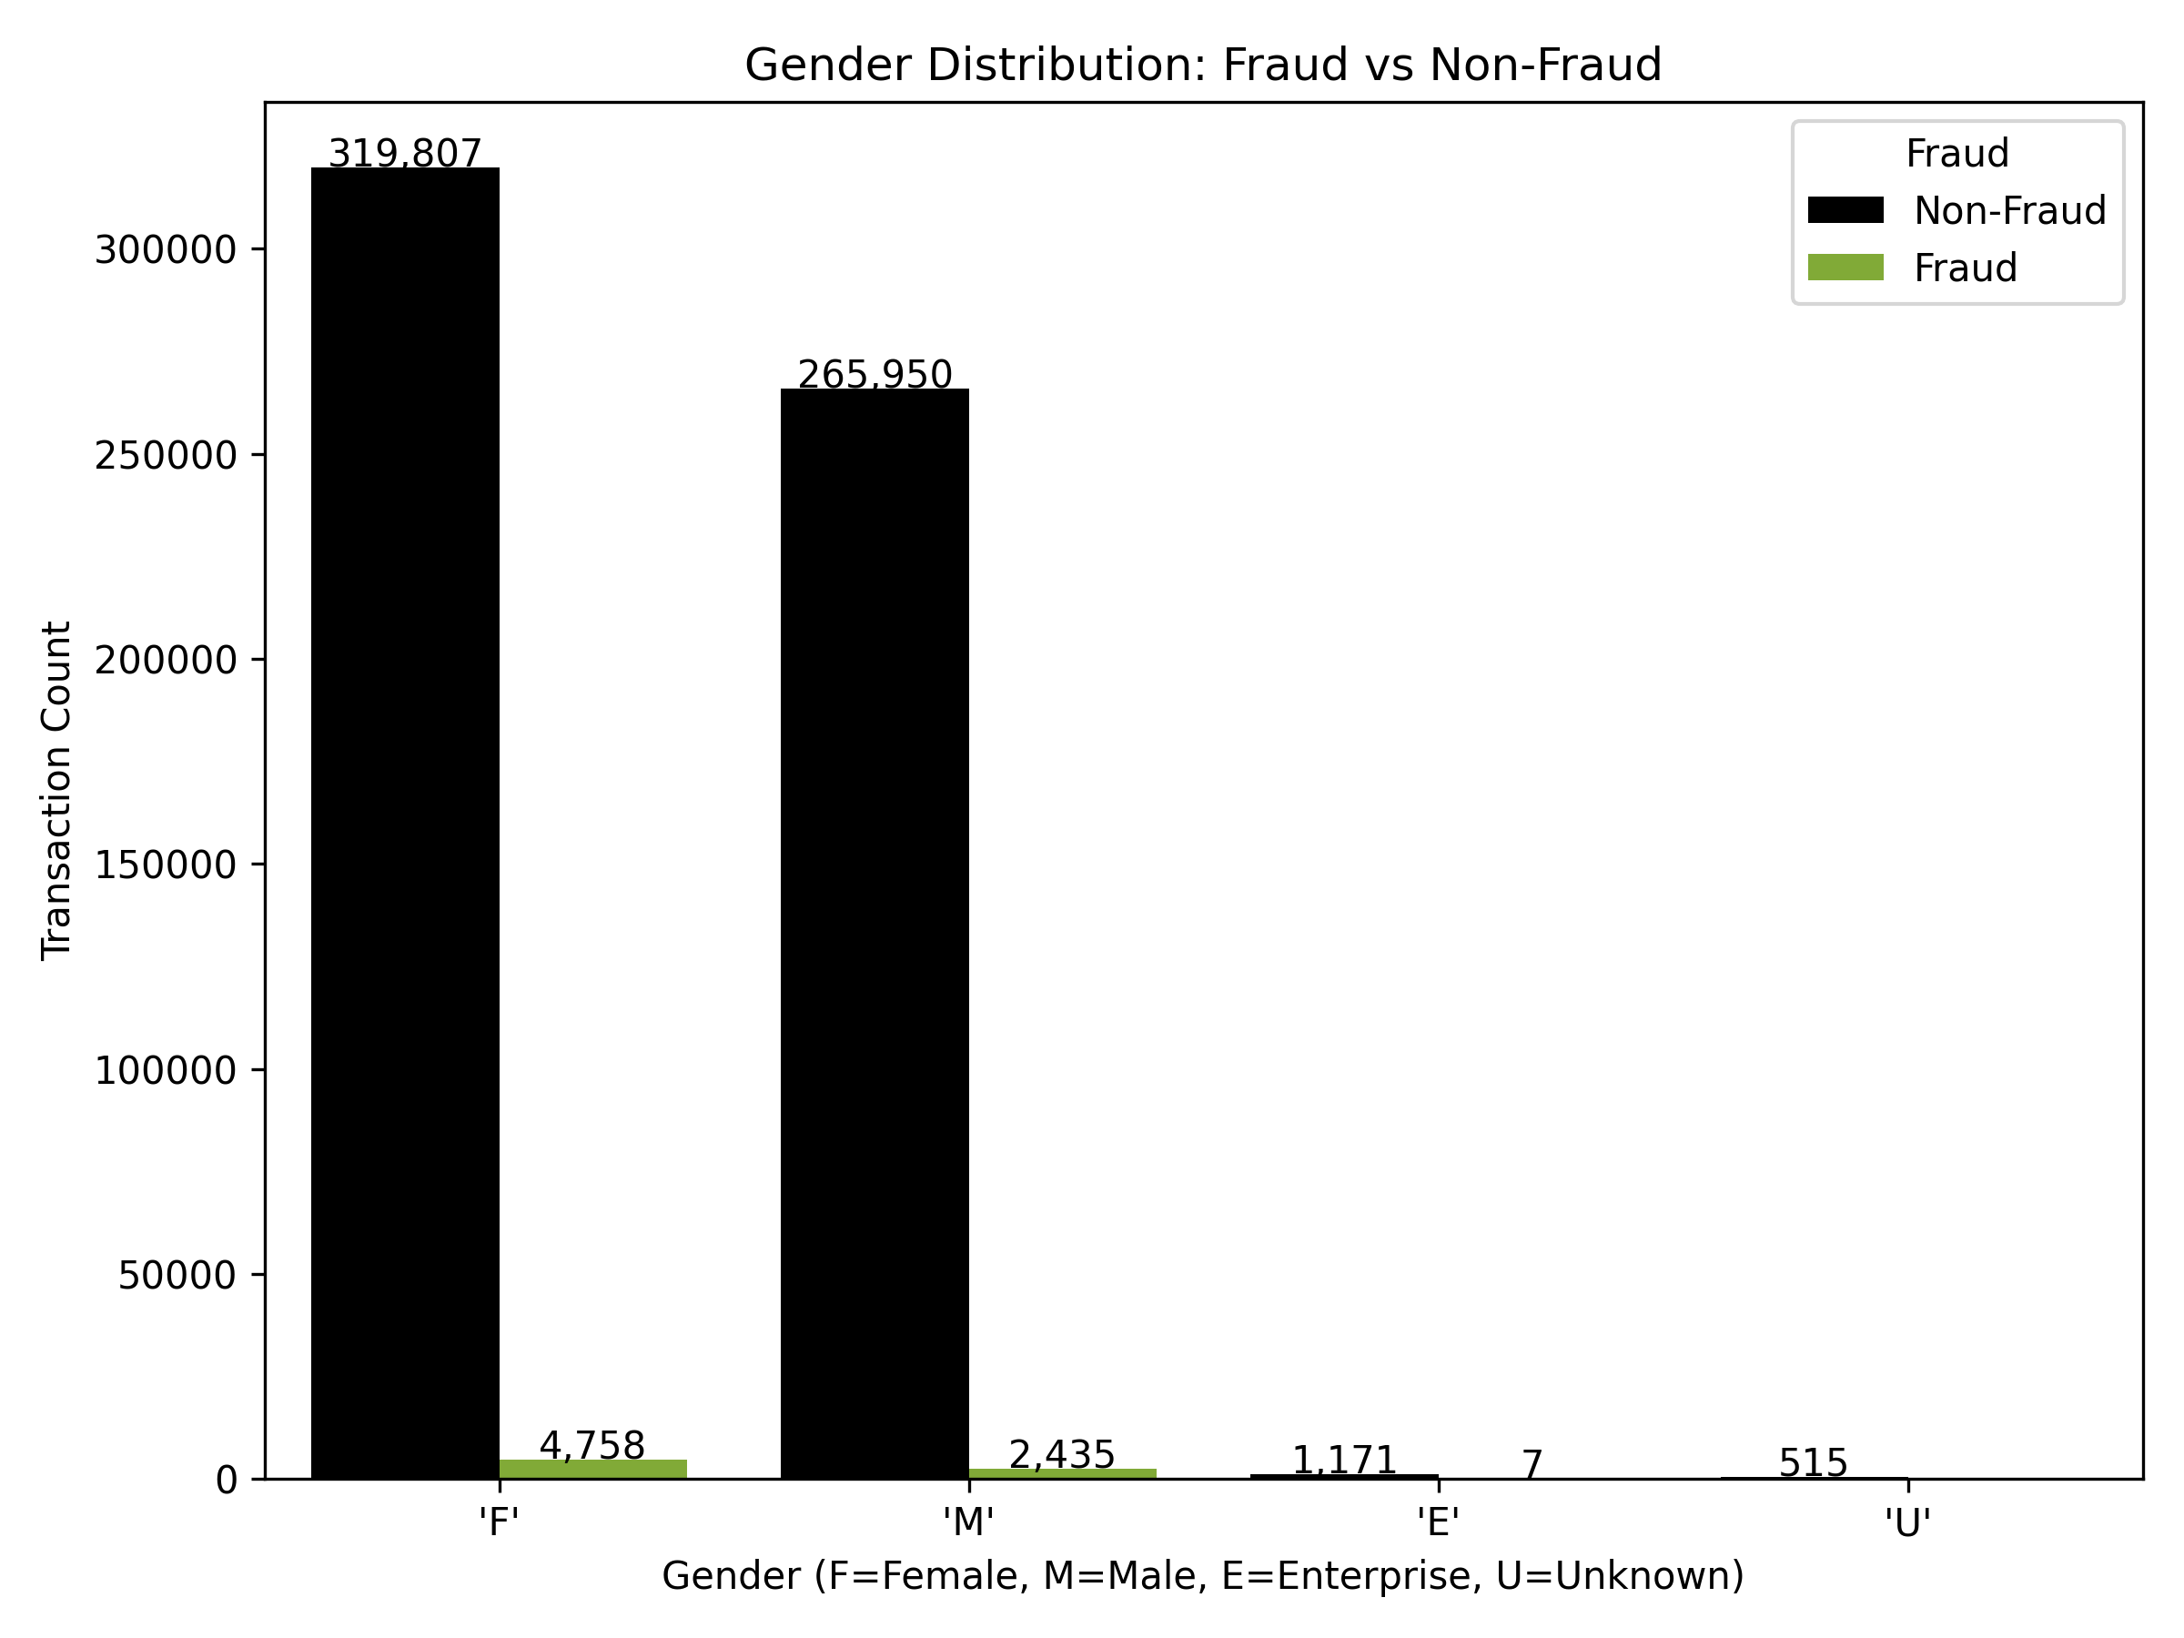
Gender Distribution: Fraud vs Non-Fraud
Most transactions from Male (M) and Female (F), with similar fraud levels.
New feature Enterprise created to capture corporate accounts.
Enterprise (E) shows higher fraud share; Unknown (U) minimal.

Slide 12
Merchant & Category Features
Merchant ID: unique merchant reference.
Category: type of purchase (travel, retail, health, etc.).
Category can have one or more Merchant ID
Both are high-cardinality features.
es_transportation
'M348934600’ 'M1823072687
es_health
'M50039827’
'M1053599405’
'M480139044’
'M692898500'
es_food
'M85975013'

Slide 13
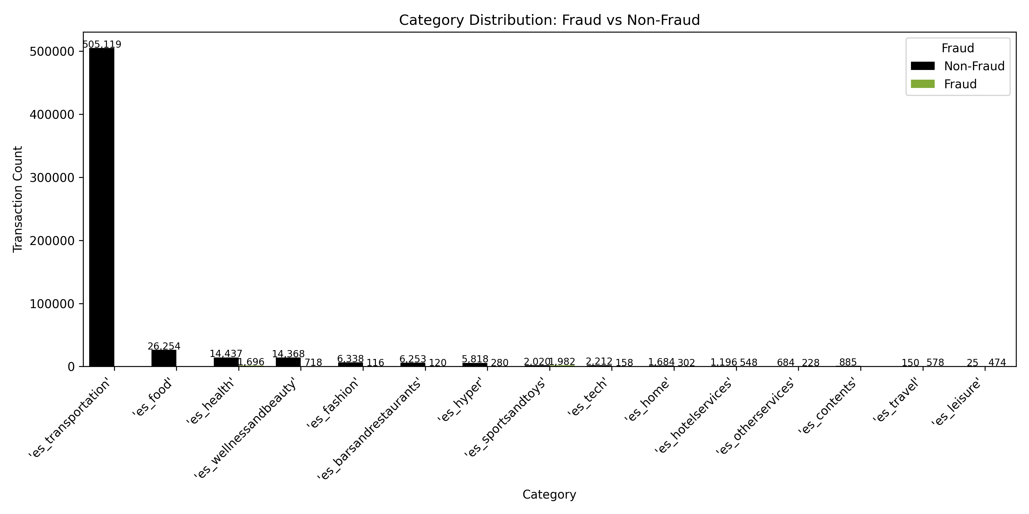
Category Distribution: Fraud vs Non-Fraud
High fraud volumes:
Health (1,696)
Sports & Toys (1,982)
Hotel services (548)
Travel (578)
Wellness & Beauty (718)
Categories with fraud concentration despite smaller size:
Leisure (474 fraud out of 499 total → ~95%)
Otherservices (228 out of 912 → ~25%)
No fraud detected in:
Food (26,254)
Transportation (505,119)
Contents (885)

Slide 14
Fraud by Merchant (within Category)
Fraud is concentrated in a few merchants inside each category.
Health → Merchant M480139044 (1,634 fraud cases).
Hotel Services → Merchants M1873032707 (216 fraud), M2011752106 (166 fraud).
Leisure → Merchant M3697346 (290 fraud).
Sports & Toys → Merchant M980657600 (1,472 fraud).
Travel → Merchant M732195782 (518 fraud).
Many categories also contain merchants with zero fraud (e.g., Food, Transportation).

Slide 15
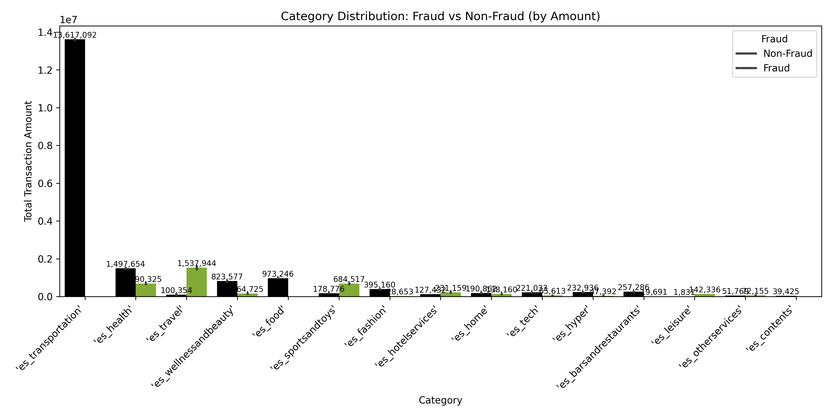
Fraud by Category (Transaction Amount)
Categories with the highest fraud exposure (by value):
Travel
Health
Sports & Toys
Hotel Services

Slide 16
Time Feature Engineering (from Step)
Step column = elapsed hours since dataset start.
Engineered two new features:
Day = step // 24 → sequential day (0–7).
Hour = step % 24 → time of day (0–23 hours).
Dataset spans 8 days (Day 0 → Day 7).
Enables analysis of daily and hourly fraud patterns, supporting detection of fraud-prone times.

Slide 17
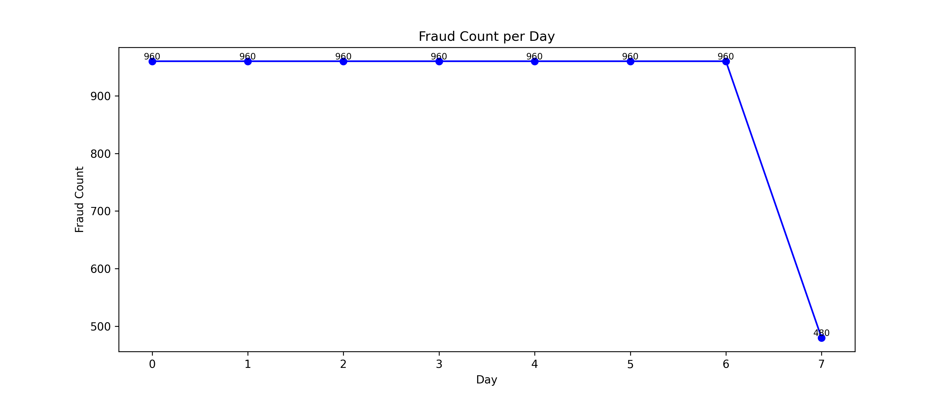
Fraud Count per Day (Feature from Step)
Fraud cases are evenly distributed across the first 7 days (960 per day).
Day 7 shows half the fraud count (480) due to the dataset ending mid-day.
Confirms that fraud is consistently present across all days, not tied to a specific date.

Slide 18
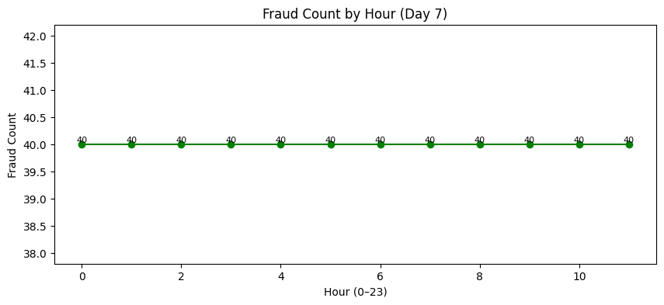
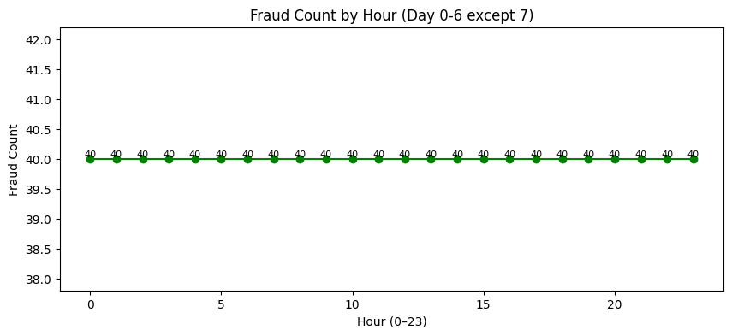
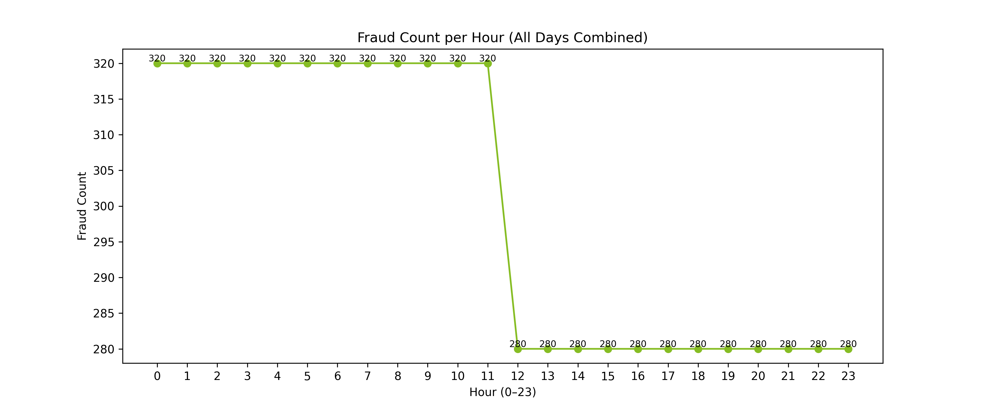
Fraud Count per Hour (Feature from Step)
Fraud counts appear mostly uniform across hours (320 cases each).
The apparent drop (to 280 cases) after hour 11 is due to the dataset ending on Day 7 (incomplete day), not a true behavioral trend.
Confirms that fraud distribution is evenly spread across the day in this dataset.

Slide 19
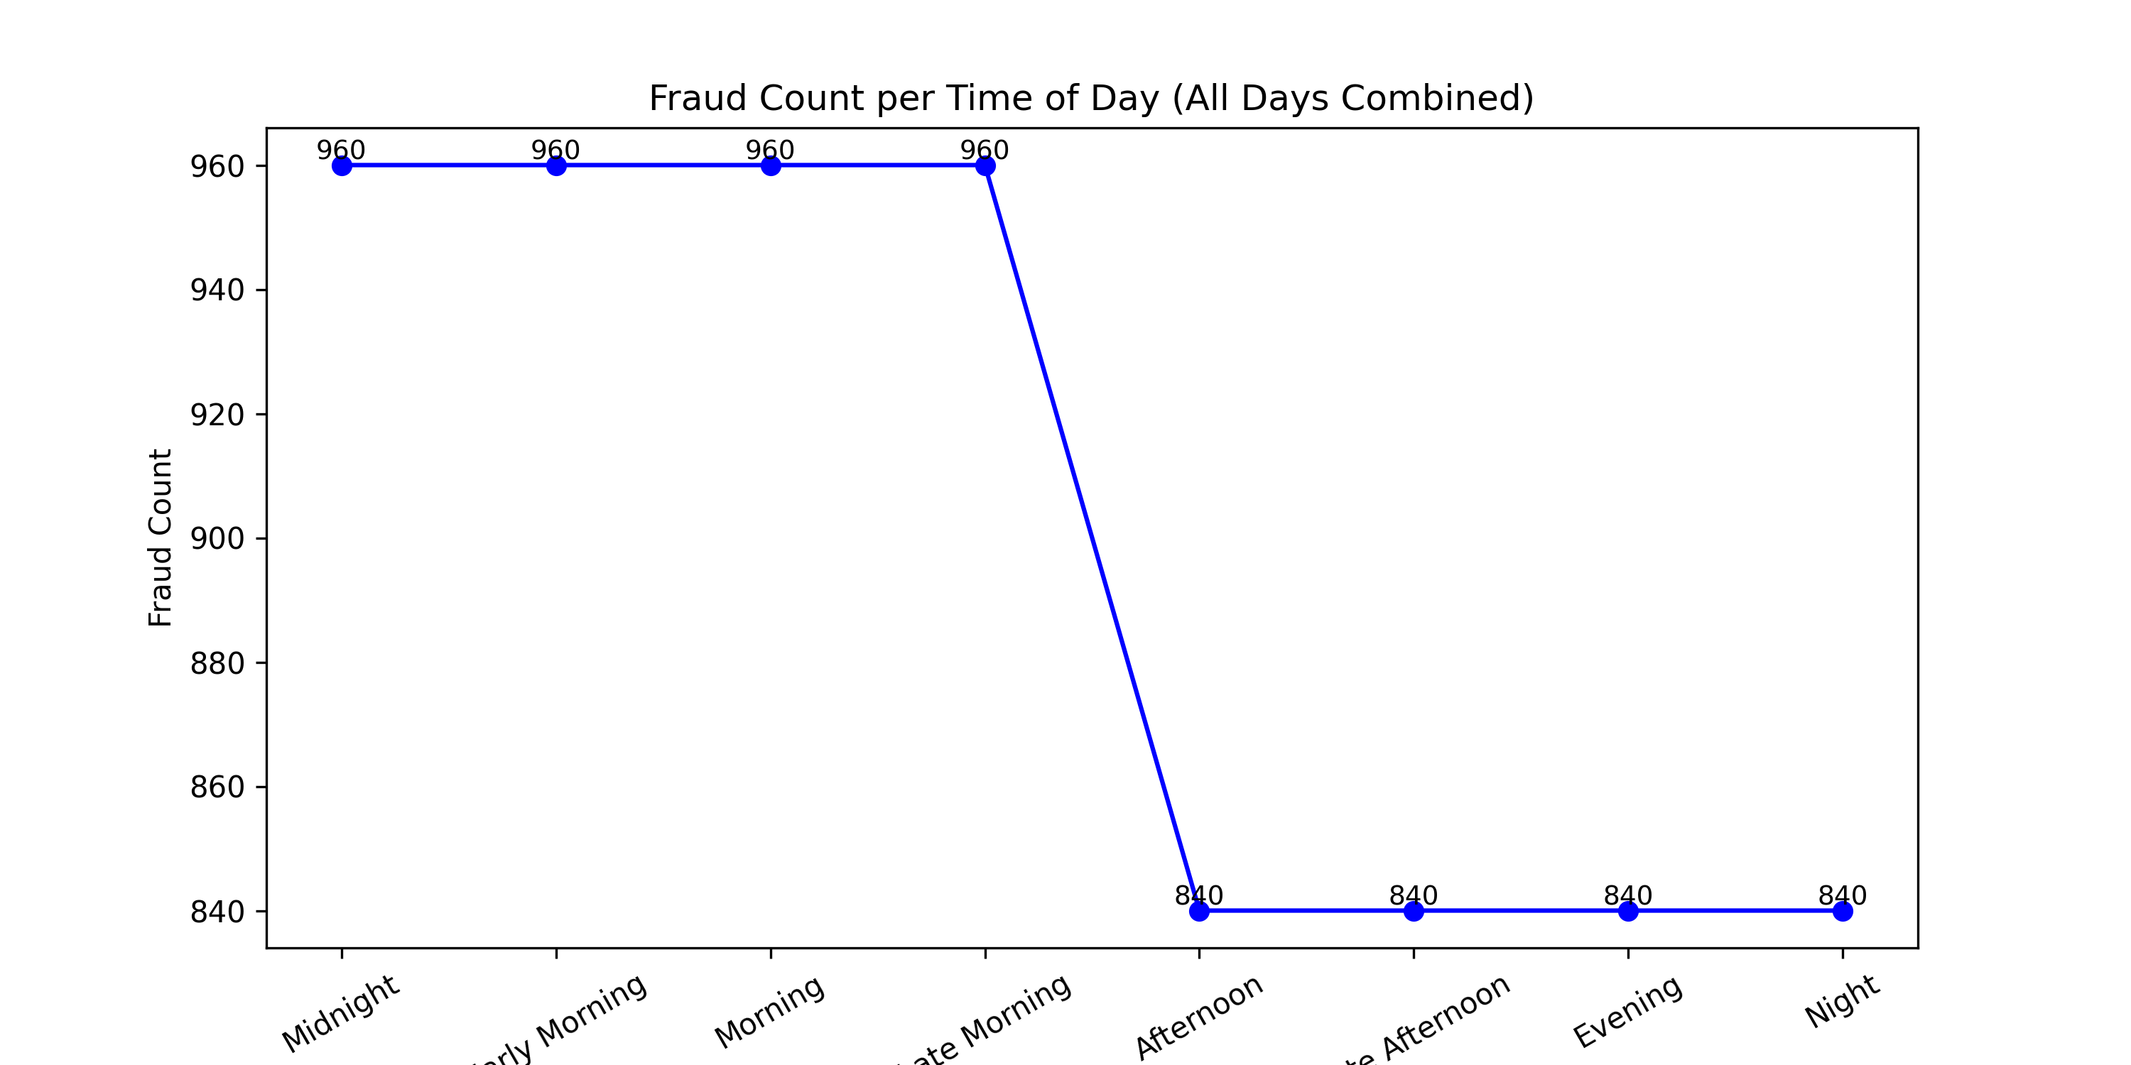
Fraud Distribution by Time of Day
Created Time of Day feature by binning hours into 8 ranges.
Midnight (0–2), Early Morning (3–5), Morning (6–8),
Late Morning (9–11), Afternoon (12–14),
Late Afternoon (15–17), Evening (18–20), Night (21–23).
Fraud counts appear stable across all bins (960 cases).
Drop to 840 cases in Afternoon–Night bins is due to dataset ending on Day 7 (partial day).

Slide 20
Feature1 | Feature2 | Feature3 | .. | .. | .. | Feature n | Target
 |  |  |  |  |  |  | 0
 |  |  |  |  |  |  | 0
 |  |  |  |  |  |  | 1
 |  |  |  |  |  |  | 0
 |  |  |  |  |  |  | 1
 |  |  |  |  |  |  | 0
 |  |  |  |  |  |  | 0
Binary Classification!
What features do we need?

Slide 21
Feature Selection
Notes:
Photo by CoWomenon Unsplash

Slide 22
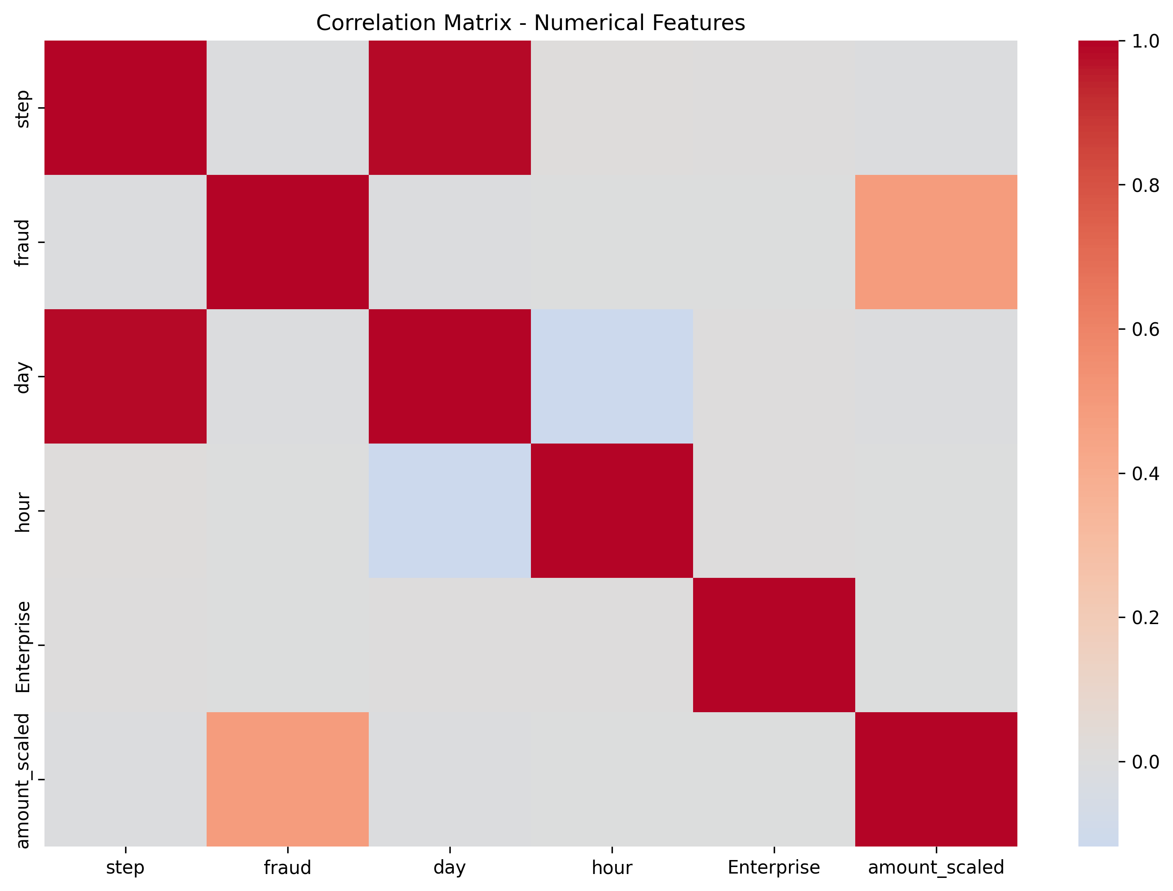
Exploration of Features
Used a correlation matrix / heatmap for numerical variables (amount, day, hour, Enterprise) → confirmed no multicollinearity.
amount showed moderate correlation with fraud → strong predictor.

Slide 23
Feature Elimination
Dropped irrelevant/redundant:
step (sequential index),
customer (unique ID),
gender (replaced by gender_new + Enterprise),
day, hour, time_of_day (sequential/redundant),
zipMerchant, zipcodeOri (single unique value).
Backward elimination → removing time_of_day improved accuracy.
Final Features for Training
Selected categorical: age, merchant, category, gender_new, Enterprise.
Selected numeric: amount.
Further refined using XGBoost feature importance → retained only top predictors (e.g., MCC_es_transportation, MERCHANT_M85975013, amount_scaled).

Slide 24
End-to-End Approach
Input Data
Data Preprocessing
ML Model
Evaluation

Slide 25
Data Preprocessing
Notes:
Photo by CoWomenon Unsplash

Slide 26
Data Preprocessing
Missing Values
One-Hot Encoding
No nulls or missing values detected in dataset
1
2
Applied to categorical features (age, merchant, category, gender_new, Enterprise).
Converts categories into numeric binary columns → required for ML models.
Data quality & consistency
dataset balanced, encoded, and scaled for reliable model training
Scaling
Handling imbalanced Data
Standardized the amount feature.
Prevents high transaction values from dominating the model.
3
4
Over Sampling or Under sampling

Slide 27
Data Splitting
Total Records: 594,643 transactions
Non-Fraud: 587,443
Fraud: 7,200
Split:
Training Set (70%) → 416,250 records
Non-Fraud: 411,210
Fraud: 5,040
Testing Set (30%) → 178,393 records
Non-Fraud: 176,233
Fraud: 2,160

Slide 28
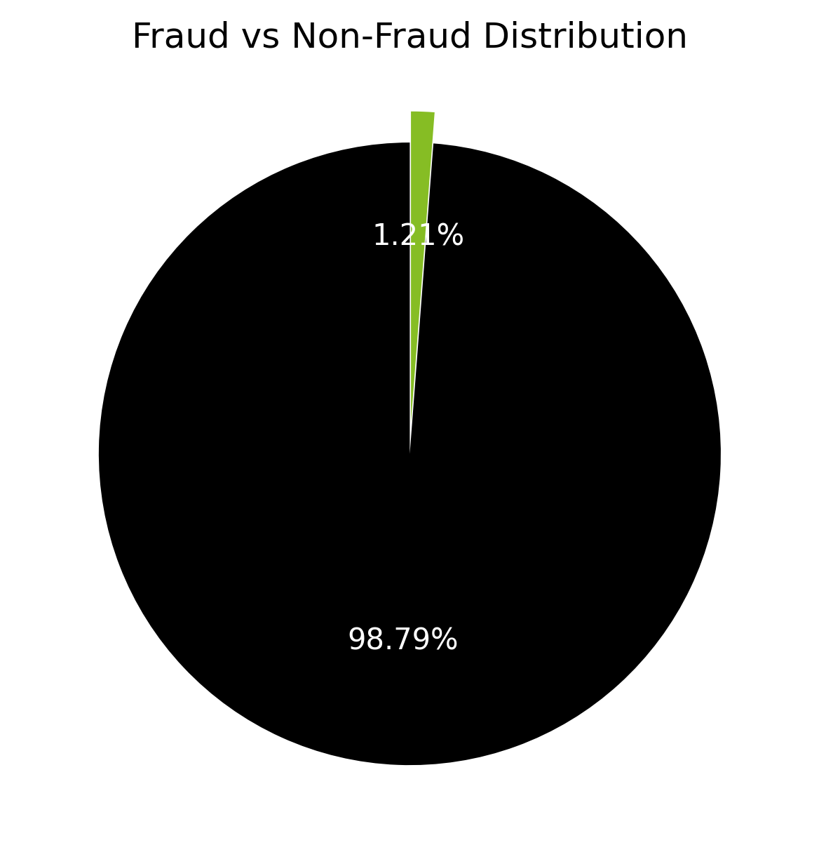
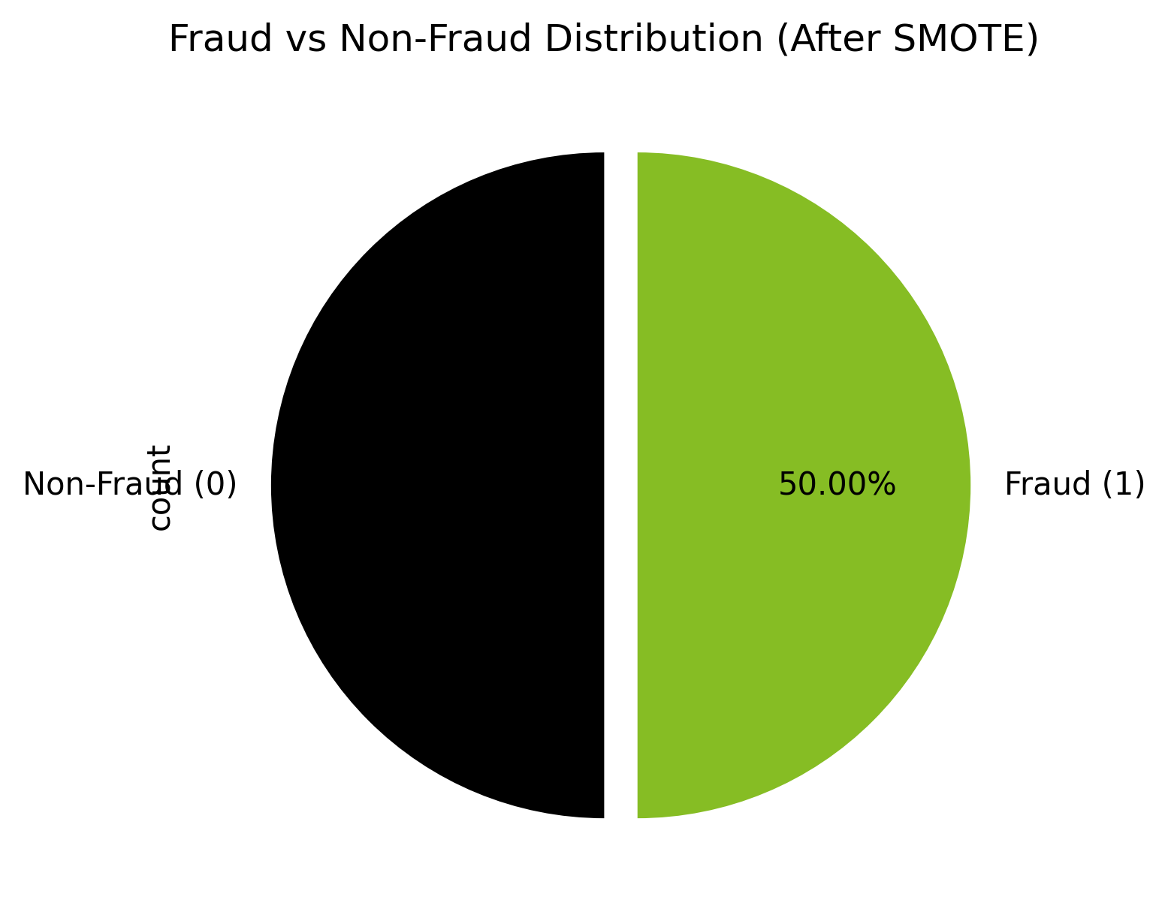
Sampling with SMOTE
Before sampling, the dataset was highly imbalanced (fraud cases were ~1%).
Fraud ≈ 1% (5,040) vs Non-Fraud ≈ 99% (411,210)
We applied SMOTE (Synthetic Minority Oversampling Technique) on the training set only.
After SMOTE, the classes became balanced (50% Fraud vs. 50% Non-Fraud).
Fraud = 411,210 | Non-Fraud = 411,210 (50/50)
This helps the model learn fraud patterns without being biased toward non-fraud.

Slide 29
Model Building & Results
Notes:
Photo by CoWomenon Unsplash

Slide 30
Model Building
Algorithms chosen:
XGBoost
A powerful gradient boosting algorithm known for high accuracy, speed, and built-in feature importance an
Logistic Regression
A simple and interpretable baseline model, fast to train and useful for benchmarking.
Random Forest
Ensemble of decision trees, handles non-linear relationships well, and reduces overfitting by averaging multiple trees.

Slide 31
Model Building
Training setup:
Used resampled (balanced) training set.
Evaluation on untouched test set.
Applied scaling / encoding from earlier preprocessing

Slide 32
Model Evaluation
Metrics Used (since accuracy alone is misleading with imbalanced data):
Accuracy → Overall correctness.
Precision → Of transactions flagged as fraud, how many are truly fraud.
Recall (Sensitivity) → Of all actual frauds, how many we successfully caught.
F1-Score → Balance between precision and recall.
AUC-ROC → Ability of the model to distinguish fraud vs. non-fraud.
Fraud cases are rare, so Recall is very important (we don’t want to miss fraud).
But high recall with low precision means too many false alarms → need a balance.
That’s why F1-score and ROC-AUC were also tracked

Slide 33
XGBoost – Confusion Matrix
 | Predicted Non-Fraud (0) | Predicted Fraud (1)
Actual Non-Fraud (0) | 172,002 (True Negative) | 4,231 (False Positive)
Actual Fraud (1) | 68 (False Negative) | 2,092 (True Positive)
Accuracy: 97.6%
Precision (Fraud=1): 0.33
Recall (Fraud=1): 0.97
F1-score (Fraud=1): 0.49
ROC-AUC: 0.997
Excellent recall (almost all frauds detected), but low precision (many false positives).

Slide 34
Random Forest – Confusion Matrix
 | Predicted Non-Fraud (0) | Predicted Fraud (1)
Actual Non-Fraud (0) | 173,065 (True Negative) | 3,168 (False Positive)
Actual Fraud (1) | 193 (False Negative) | 1,967 (True Positive)
Accuracy: 98.1%
Precision (Fraud=1): 0.38
Recall (Fraud=1): 0.91
F1-score (Fraud=1): 0.54
ROC-AUC: 0.986
Best balance between precision and recall compared to others

Slide 35
Best Performance Logistic Regression – Confusion Matrix
 | Predicted Non-Fraud (0) | Predicted Fraud (1)
Actual Non-Fraud (0) | 171,788 (True Negative) | 4,445 (False Positive)
Actual Fraud (1) | 52 (False Negative) | 2,108 (True Positive)
Accuracy: 97.5%
Precision (Fraud=1): 0.32
Recall (Fraud=1): 0.98
F1-score (Fraud=1): 0.48
ROC-AUC: 0.997
Simple but very strong model. Matches XGBoost’s ROC-AUC, with similar recall

Slide 36
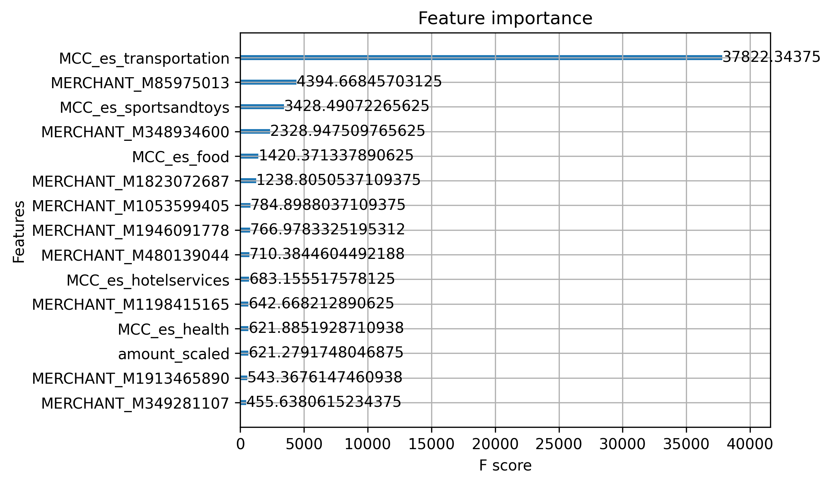
Feature Importance Xgboost – Top 15
Fraud prediction mainly driven by Category (MCC) and Merchant IDs.
Top Features:
MCC_es_transportation
Merchant M85975013
MCC_es_sportsandtoys
Merchant M348934600
MCC_es_food

Slide 37
XGBoost Top (15) – Confusion Matrix
 | Predicted Non-Fraud (0) | Predicted Fraud (1)
Actual Non-Fraud (0) | 168,763 (True Negative) | 7,470 (False Positive)
Actual Fraud (1) | 60 (False Negative) | 2,100 (True Positive)
Accuracy: 96.0%
Precision (Fraud=1): 0.22
Recall (Fraud=1): 0.97
F1-score (Fraud=1): 0.36
ROC-AUC: 0.995
Dropping features reduced precision/F1

Slide 38
Models Comparison
Model | Accuracy | Precision (Fraud=1) | Recall (Fraud=1) | F1-score (Fraud=1) | ROC-AUC
XGBoost (All Features) | 97.6% | 0.33 | 0.97 | 0.49 | 0.997
XGBoost (Top 15 Features) | 96.0% | 0.22 | 0.97 | 0.36 | 0.995
Random Forest | 98.1% | 0.38 | 0.91 | 0.54 | 0.986
Logistic Regression | 97.5% | 0.32 | 0.98 | 0.48 | 0.997
We evaluated XGBoost, Random Forest, and Logistic Regression using Accuracy, Precision, Recall, F1-score, and ROC-AUC.
Recall is high across all models (good at catching fraud), but precision is low (many false positives).
Random Forest balances slightly better precision and F1 compared to XGBoost/LogReg.
XGBoost and Logistic Regression achieved the highest ROC-AUC (~0.997), showing strong separation ability.
Using Top 15 Features in XGBoost reduced precision/F1 — showing that dropping too many variables hurt predictive power.

Slide 39
Business Impact
The Core Trade-Off: Security vs. Convenience
In fraud detection, every model must balance two competing priorities:
Catching Fraud (Recall): Preventing financial loss by identifying as many fraudulent transactions as possible.
Avoiding False Alarms (Precision): Ensuring legitimate customers are not inconvenienced by having their transactions blocked.
Our Strategic Decision: Prioritize Security
Given the high financial and reputational cost of a single missed fraud, we have made a deliberate business decision to prioritize security. Our strategy is to accept a higher rate of false alarms as an acceptable cost to achieve the lowest possible fraud loss.
Impact of Our Recommended Model (Logistic Regression)
Financial Impact (Positive):
By catching 98% of all fraudulent activity, the model will drastically reduce direct financial losses. This represents a significant and immediate return on investment.
Operational Impact (Manageable):
The model will produce more alerts for the fraud investigation team to review.
Mitigation: We can use the model's probability scores to create a tiered alert system, allowing the team to focus on the highest-risk transactions first, improving efficiency.
Customer Impact (Controlled):
A higher number of legitimate transactions will be flagged for review.
Mitigation: This can be managed through clear customer communication and a streamlined, rapid review process to minimize disruption. The long-term benefit of enhanced security protects and builds customer trust.

Slide 40
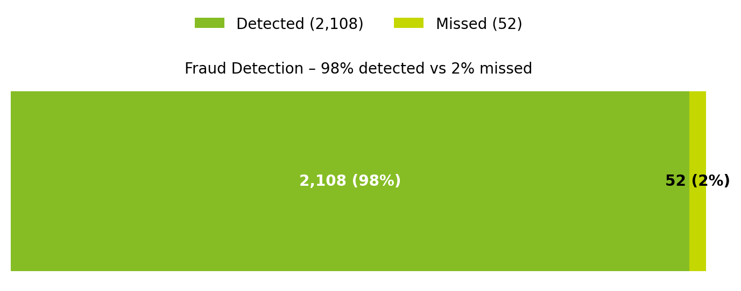
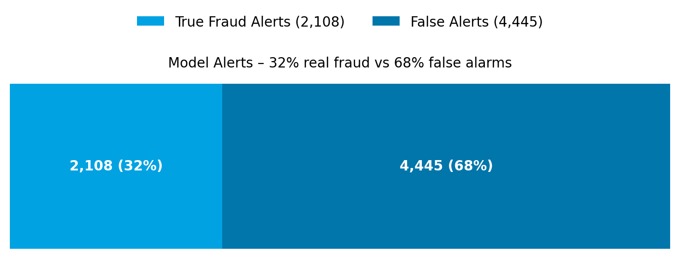
Business Impact – Fraud Model Trade-offs
Our fraud detection model proved highly effective, identifying 98% of all fraud cases with only 52 missed incidents.
This high recall not only strengthens customer protection but also demonstrates strong effectiveness in reducing financial risk.
Most importantly, the model prevented losses of 1.19 million JOD, with only 2.4 thousand JOD slipping through—a remarkable 99.8% of attempted fraud stopped by value.
While 68% of alerts were false positives, they represent a manageable operational cost, as investigating additional cases is far less costly than missing even a single fraud.

Slide 41
Key outcomes & Recommendations
Key Outcomes
Fraudulent transactions show distinct patterns in:
Built and evaluated multiple models (Logistic Regression, Random Forest, XGBoost).
Specific high-risk merchants repeatedly associated with fraud.
Logistic Regression achieved the highest performance/ Accuracy with ROC-AUC ~0.997, strong fraud detection capability.
Transaction amounts (fraud cases tend to cluster in higher ranges).
Merchant Categories (e.g., transportation, sports/toys, food).
Feature engineering (day, hour, time-of-day bins) provided insights into fraud timing trends.
Data imbalance resolved using SMOTE oversampling, improving fraud detection recall.

Slide 42
Recommendations for Business Teams
Targeted Controls: Prioritize monitoring for high-risk categories and merchants.
Dynamic Thresholds: Adjust fraud detection thresholds by transaction size and time of day.
Operational Integration: Embed the Logistic Regression model into transaction monitoring workflows.
Continuous Learning: Establish a cycle of model retraining to adapt to evolving fraud patterns.
Business Alignment: Share insights with risk/compliance teams to refine policies and minimize customer disruption.

Slide 43

Thank You
Notes:
Photo by Charles Forerunneron Unsplash

